Slide 1

Geometry
Unit 13, Lesson 10 Classifying Quadrilaterals – Part 3 Volume 2, pg. 339

Slide 2


Benchmark
MA.912.GR.3.2
Given a mathematical context, use coordinate geometry to classify or justify definitions, properties, and theorems involving circles, triangles, or quadrilaterals.
volume 2, pg. 339

Slide 3
Integrated Mathematical Thinking and Reasoning Standards
MA.K12.MTR.1.1 Actively participate in effortful learning both individually and collectively.
MA.K12.MTR.2.1 Demonstrate understanding by representing problems in multiple ways.
MA.K12.MTR.4.1 Engage in discussions that reflect on the mathematical thinking of self and others.
MA.K12.MTR.5.1 Use patterns and structure to help understand and connect mathematical concepts.
volume 2, pg. 339

Slide 4

Learning Target
I can use coordinate geometry to classify quadrilaterals based on their properties in a mathematical or real-world context.
volume 2, pg. 339

Slide 5

Warm-Up
volume 2, pg. 340

Slide 6
13.10.1 Warm-Up: Would You Rather?
Would you rather …
Give up watching movies?
Give up watching TV shows?
OR
Explain your choice.
volume 2, pg. 340

Slide 7

Activity
volume 2, pg. 340

Slide 8
13.10.2 Activity: Stations
Complete the table for each question card.
Question | Work |  | Answer
1 | Slopes |  | Properties
 | Side Lengths
 | Diagonal Lengths |  | Quadrilateral
volume 2, pg. 340

Slide 9
Question | Work |  | Answer
2 | Slopes |  | Properties
 | Side Lengths
 | Diagonal Lengths |  | Quadrilateral
volume 2, pg. 341

Slide 10
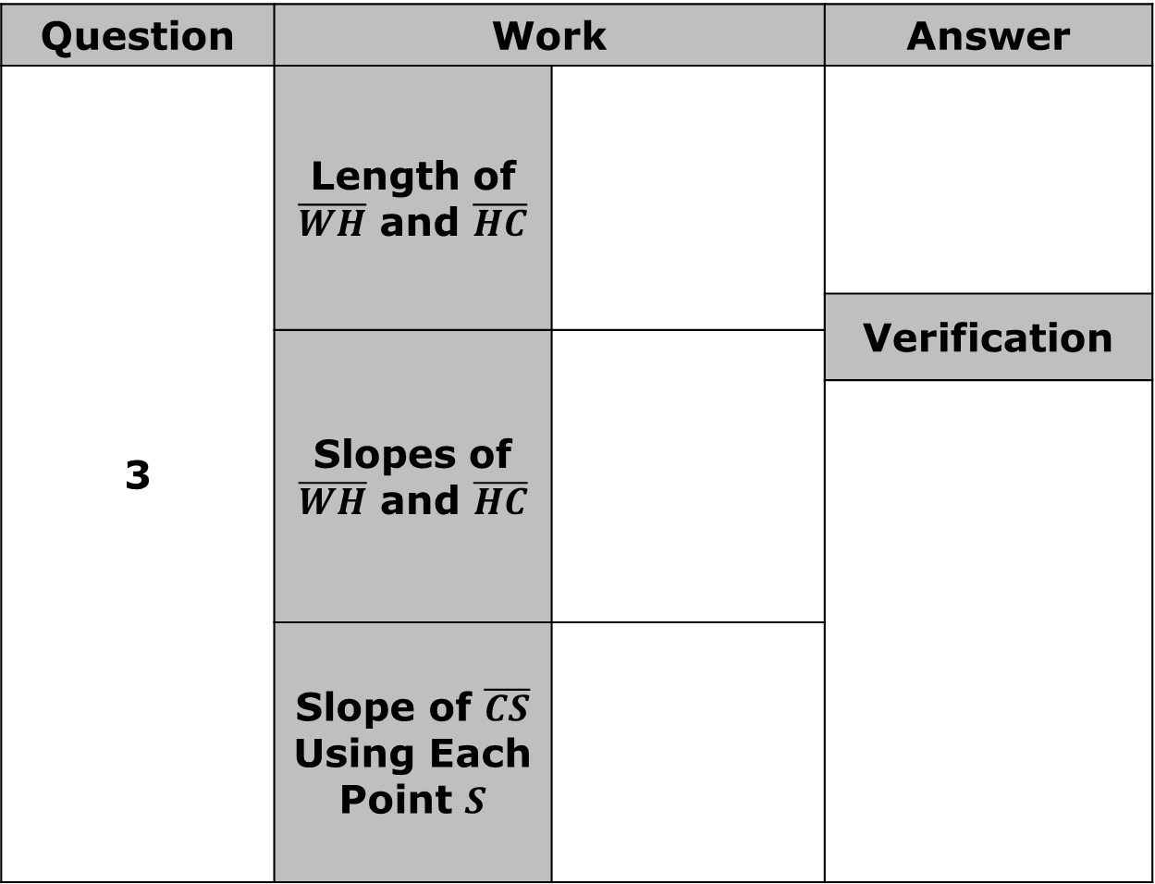
Question | Work |  | Answer
3 | Length of $\overline{WH}$ and $\overline{HC}$
 |  |  | Verification
 | Slopes of $\overline{WH}$ and $\overline{HC}$
 | Slope of $\overline{CS}$ Using Each Point $S$
volume 2, pg. 341

Slide 11
Question | Work |  | Answer
4 | Slopes |  | Properties
 | Side Lengths
 | Diagonal Lengths |  | Who is correct?
volume 2, pg. 342

Slide 12
Question | Work |  | Answer
5 | Slopes |  | Properties
 | Side Lengths
 | Diagonal Lengths |  | Quadrilateral
volume 2, pg. 342

Slide 13
Question | Work |  | Answer
6 | Slopes |  | Which quadrilateral is a rectangle?
 | Side Lengths |  | Properties
 | Diagonal Lengths
volume 2, pg. 343

Slide 14
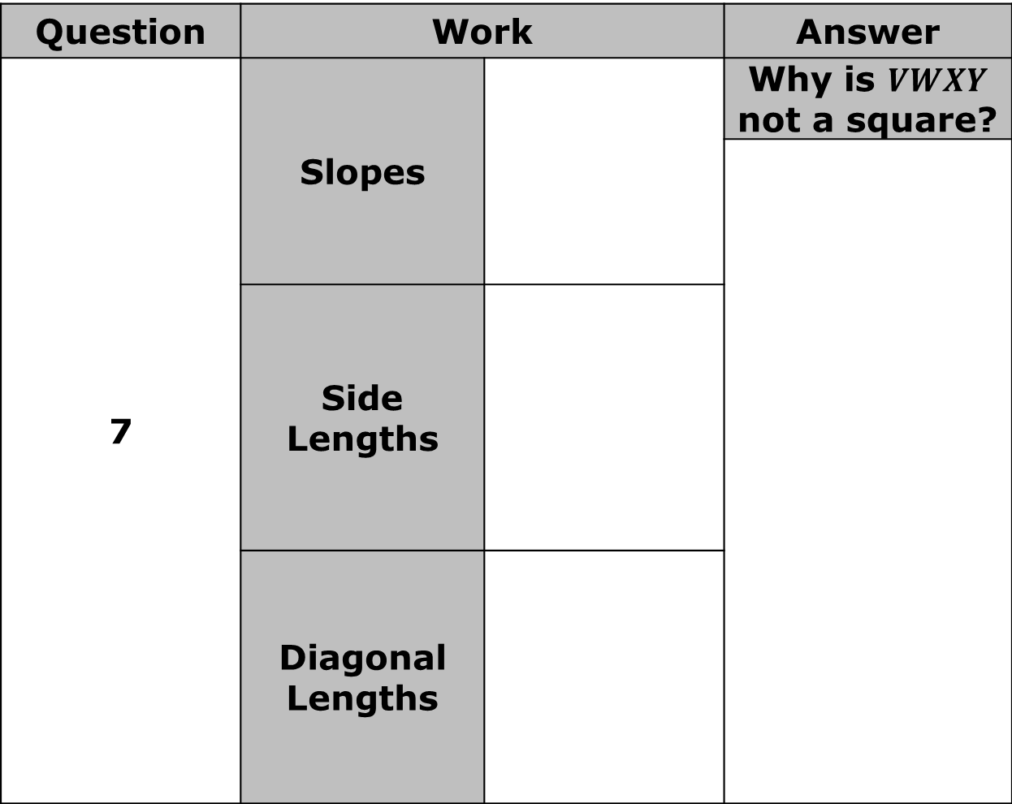
Question | Work |  | Answer
7 | Slopes |  | Why is $VWXY$ not a square?
 | Side Lengths
 | Diagonal Lengths
volume 2, pg. 343

Slide 15
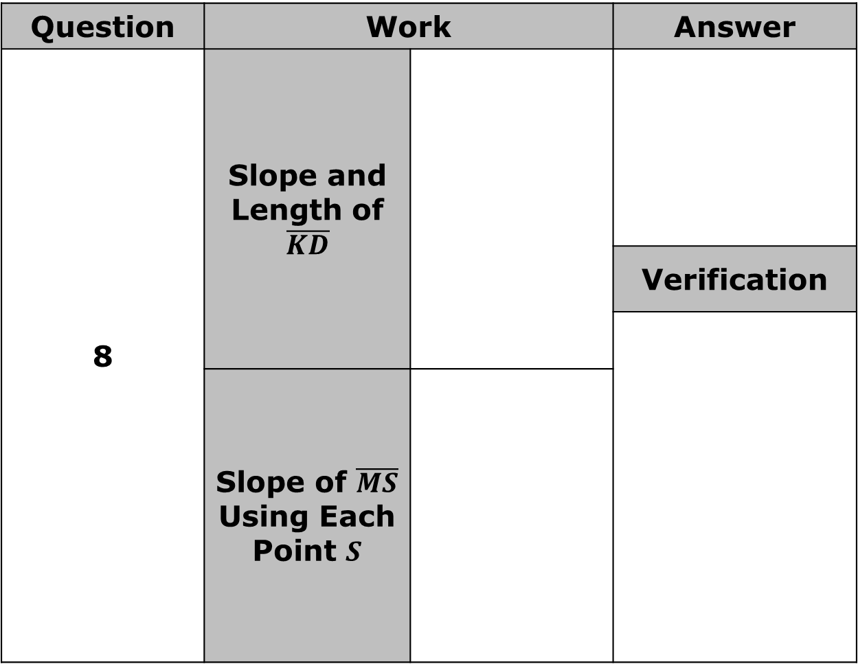
Question | Work |  | Answer
8 | Slope and Length of $\overline{KD}$
 |  |  | Verification
 | Slope of $\overline{MS}$ Using Each Point $S$
volume 2, pg. 344

Slide 16

Wrap-Up
volume 2, pg. 344

Slide 17
13.10.3 Wrap-Up: Reflection
Write a short note to a friend who missed today’s class summarizing what you learned.
volume 2, pg. 344

